Slide 1
EIT x Soft Robots: project update
Week of Monday 23/08/2021

Slide 2
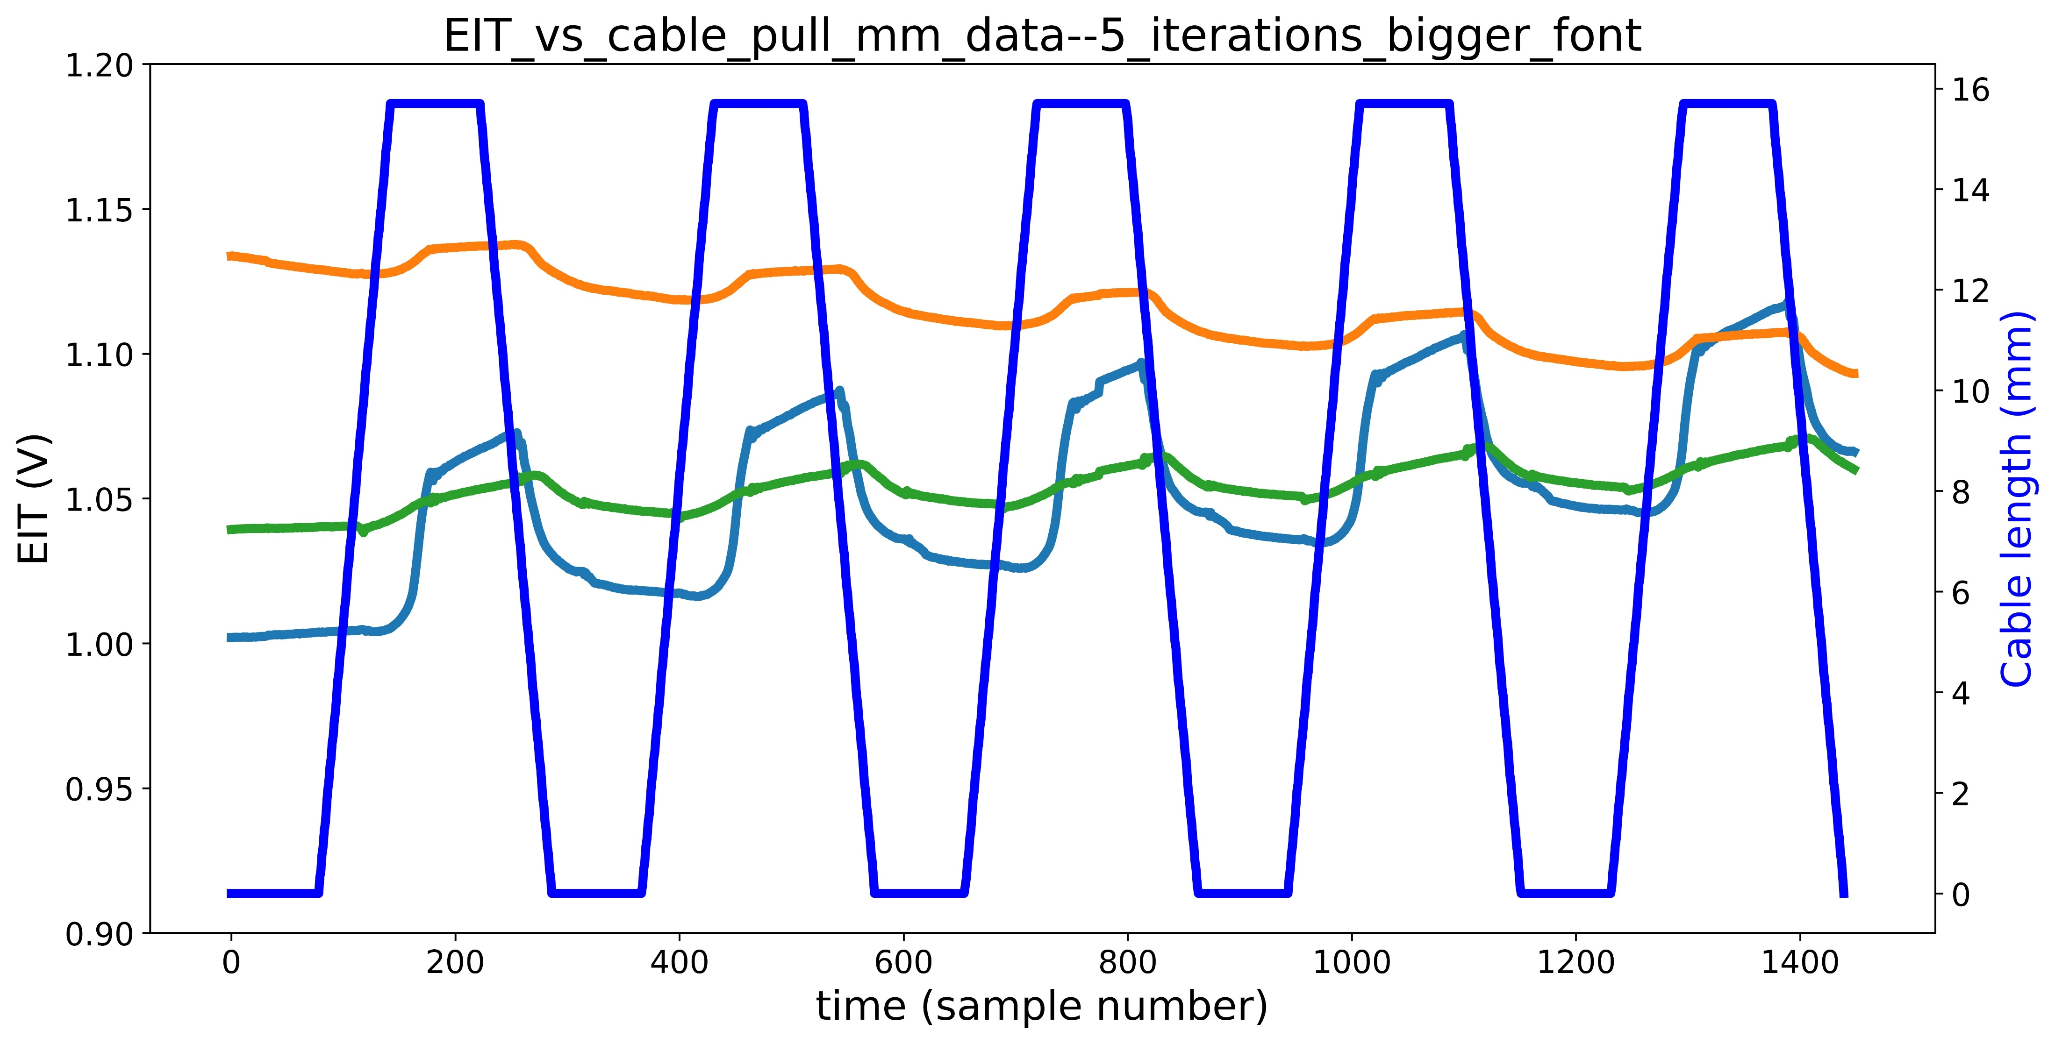
Copper wire actuator data – clarifications/investigations
Drift caused by eroding electrodes/air bubbles
EIT vs cable pull mm data
1
2
3

Slide 3
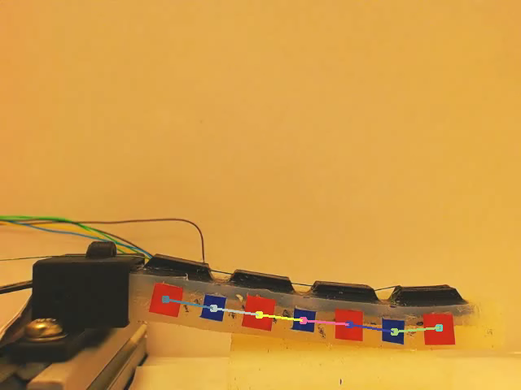
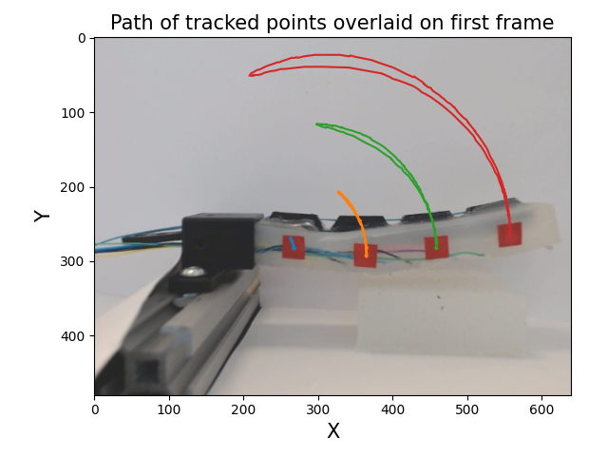
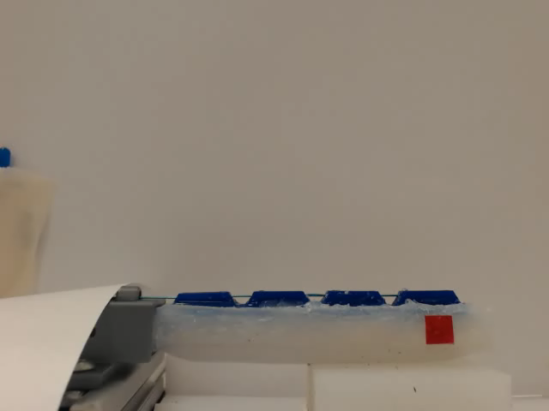
Computer vision progress
Units are pixels

Slide 4
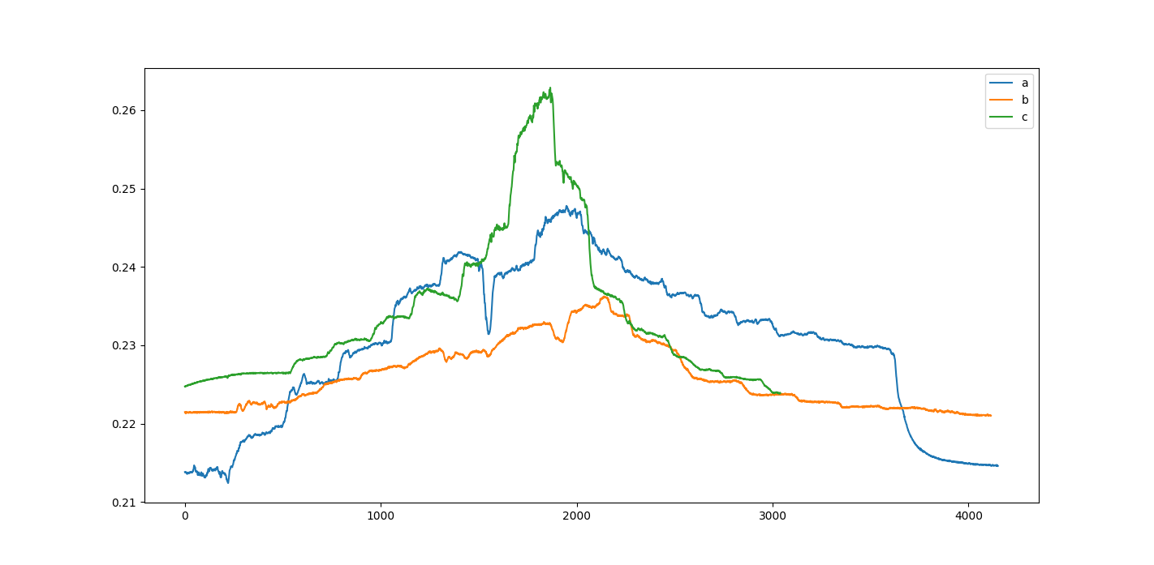
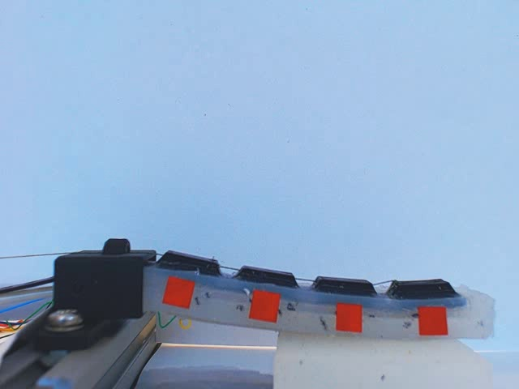
10-degree increment bending of actuator joints
c
b
a
Voltage (V)
Samples (40 Hz)

Slide 5
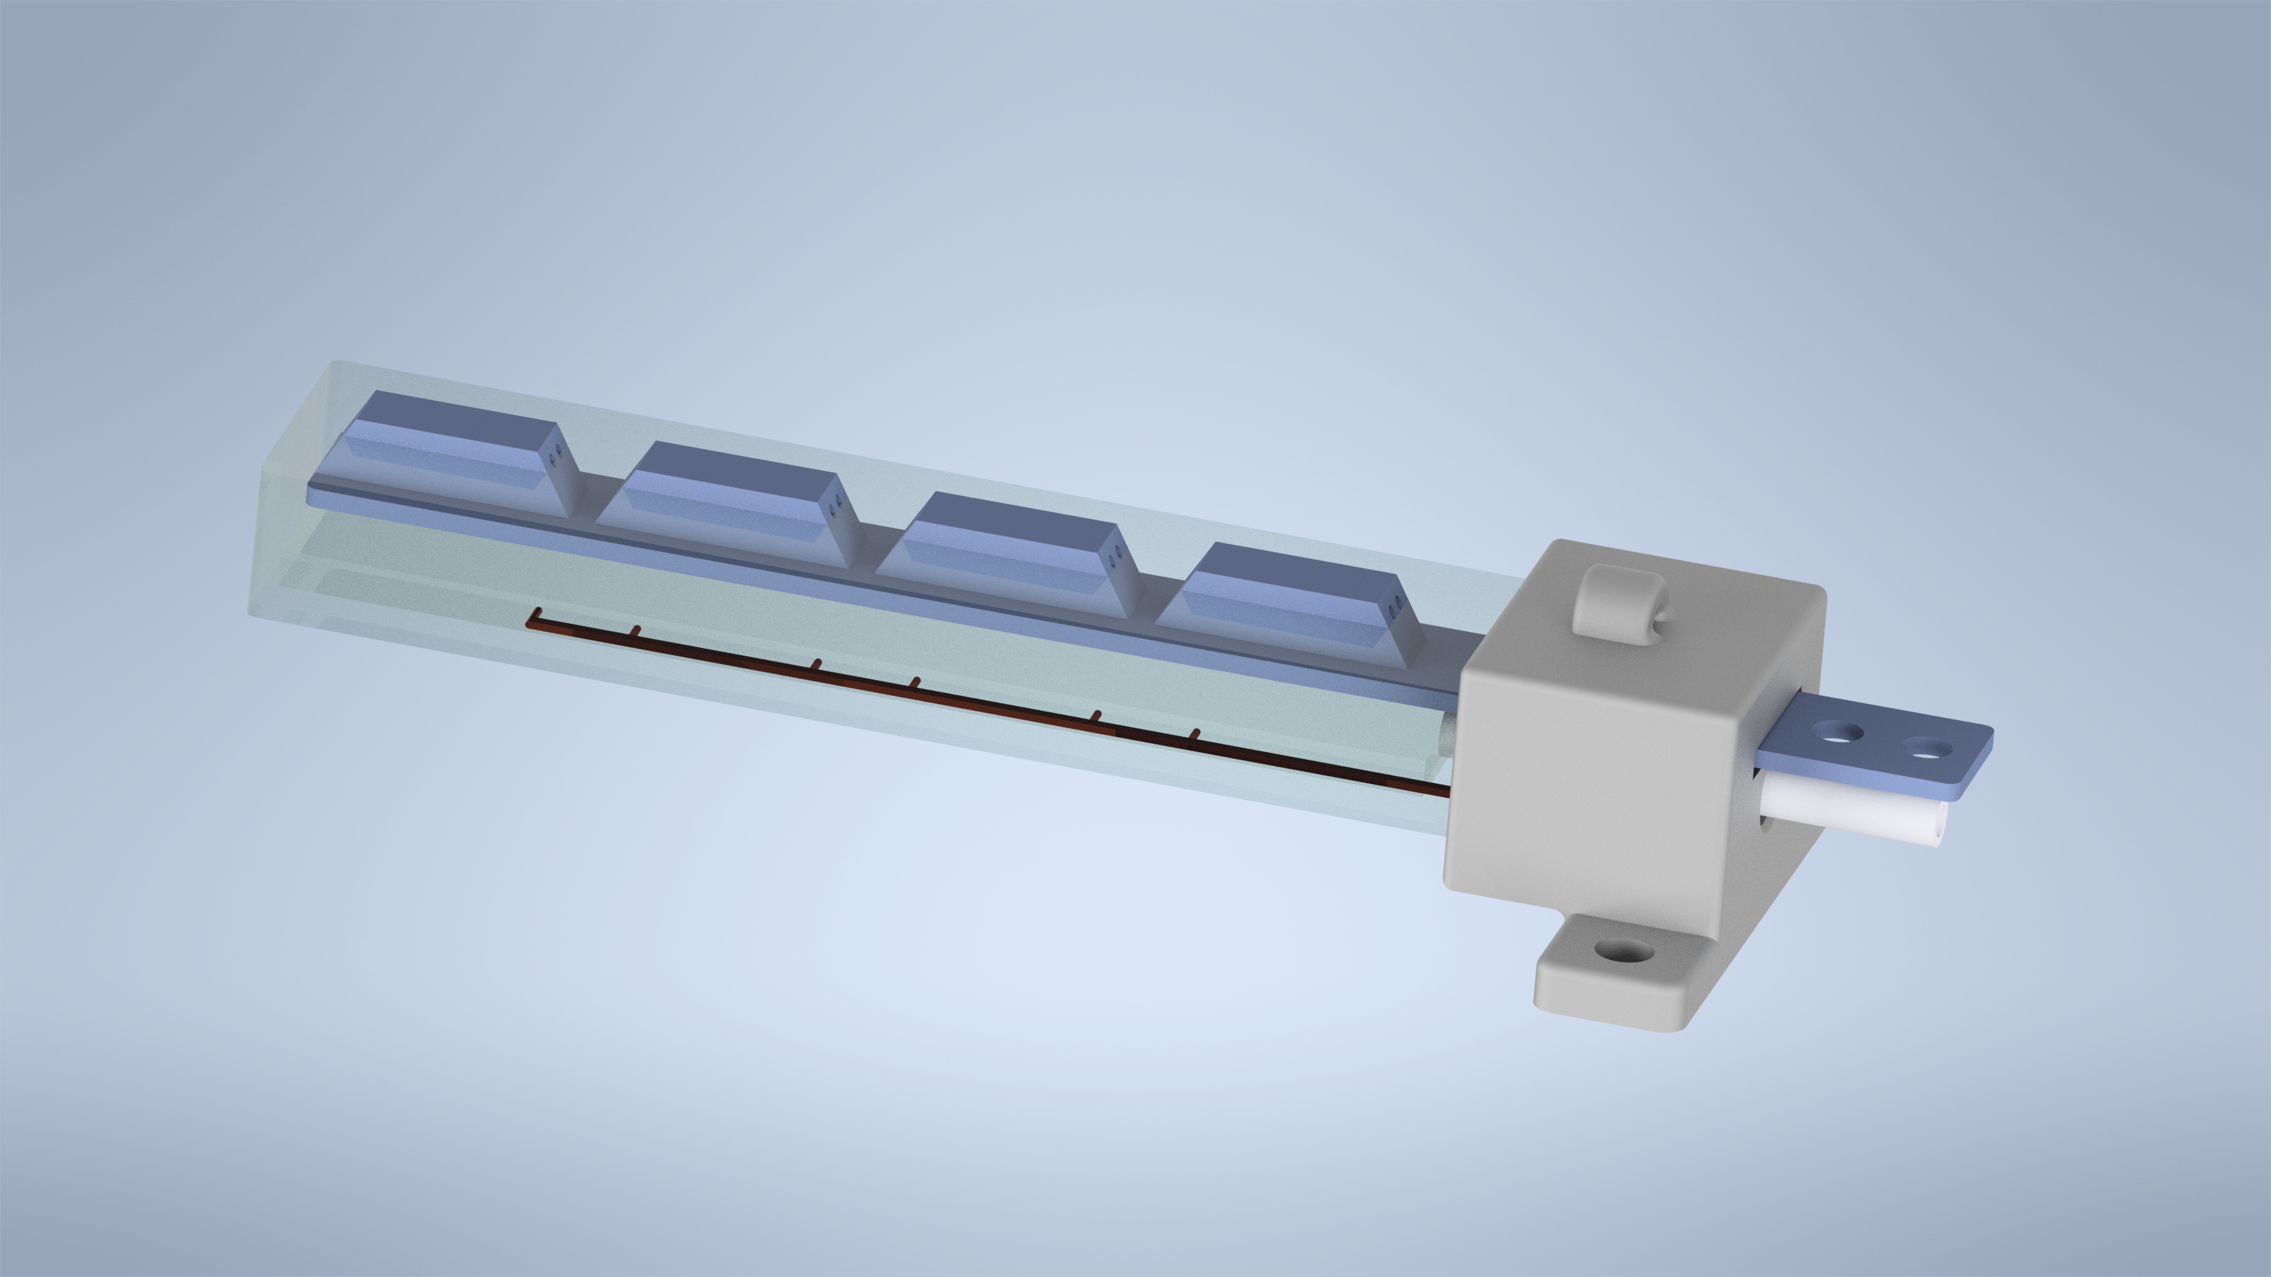
Ground truth acquisition: 1 angle

Slide 6
TODO
Questions
Refine pipeline for acquiring data (from DAQ, Arduino, and webcam)
Feed data into ML script (start simple with linear regression, also develop LSTM)
Actual thesis writing

